Slide 1
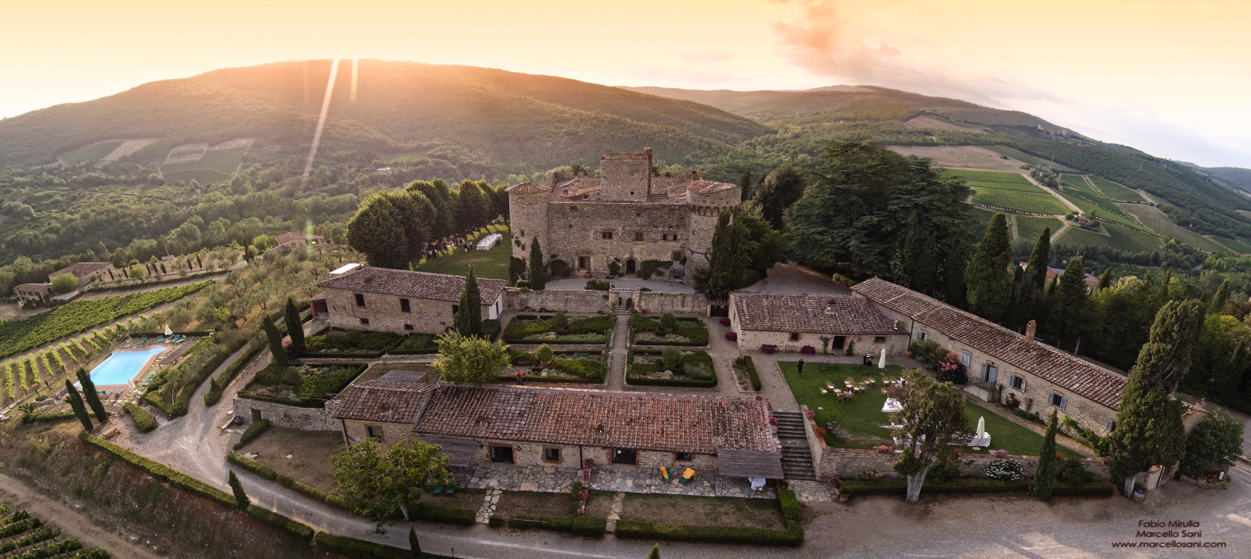
Castello di Meleto 梅雷托堡
The next wines come from Castello di Meleto, Italy.
接下来的美酒，来自轩乐，意大利梅雷托堡酒庄

Slide 2
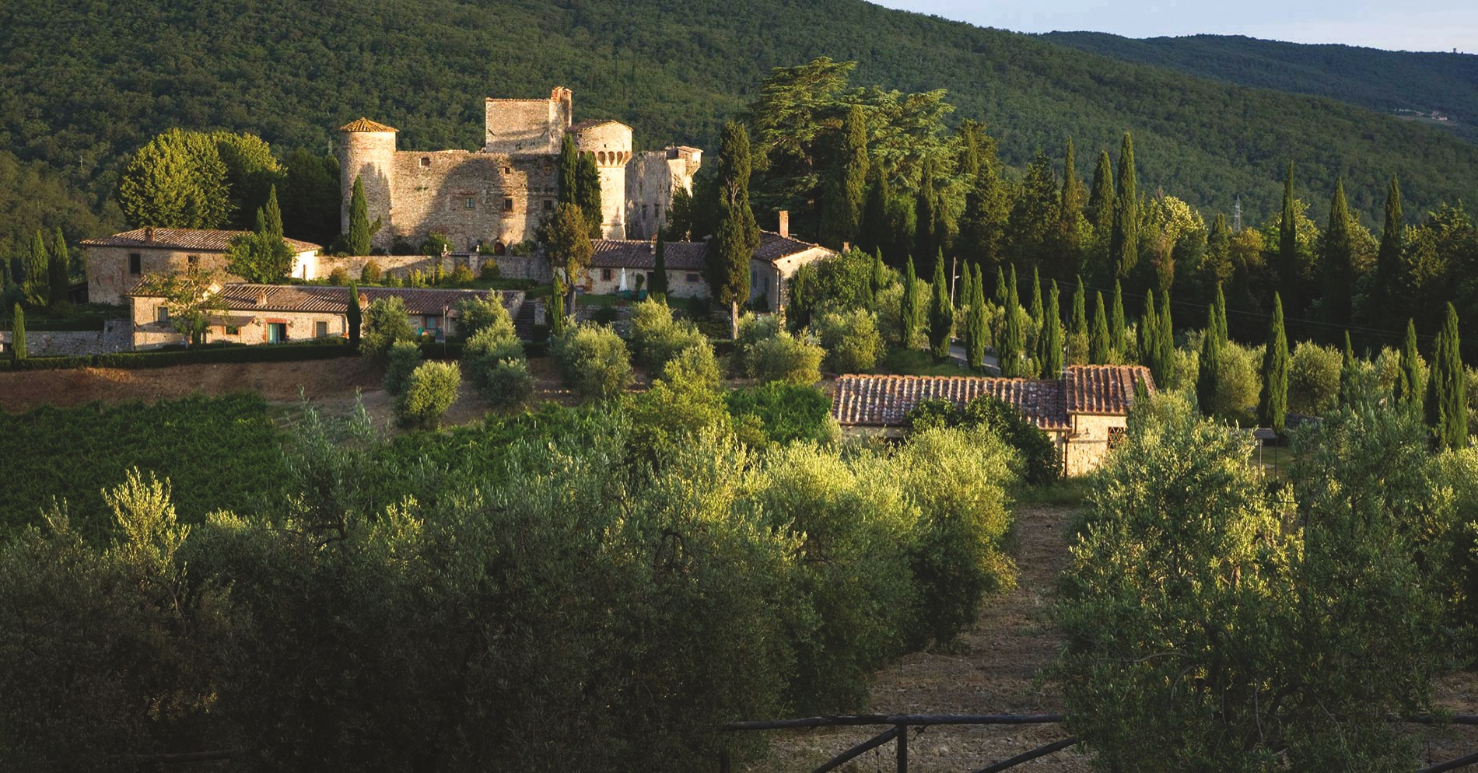
梅雷托堡第一次见于史籍是在1256年，佛罗伦萨教皇派的年度预算手册上，将其作为瑞卡索家族的产业列入。该家族后来也成为基安蒂葡萄酒历史上留有浓郁色彩的家族之一。

Slide 3


Slide 4
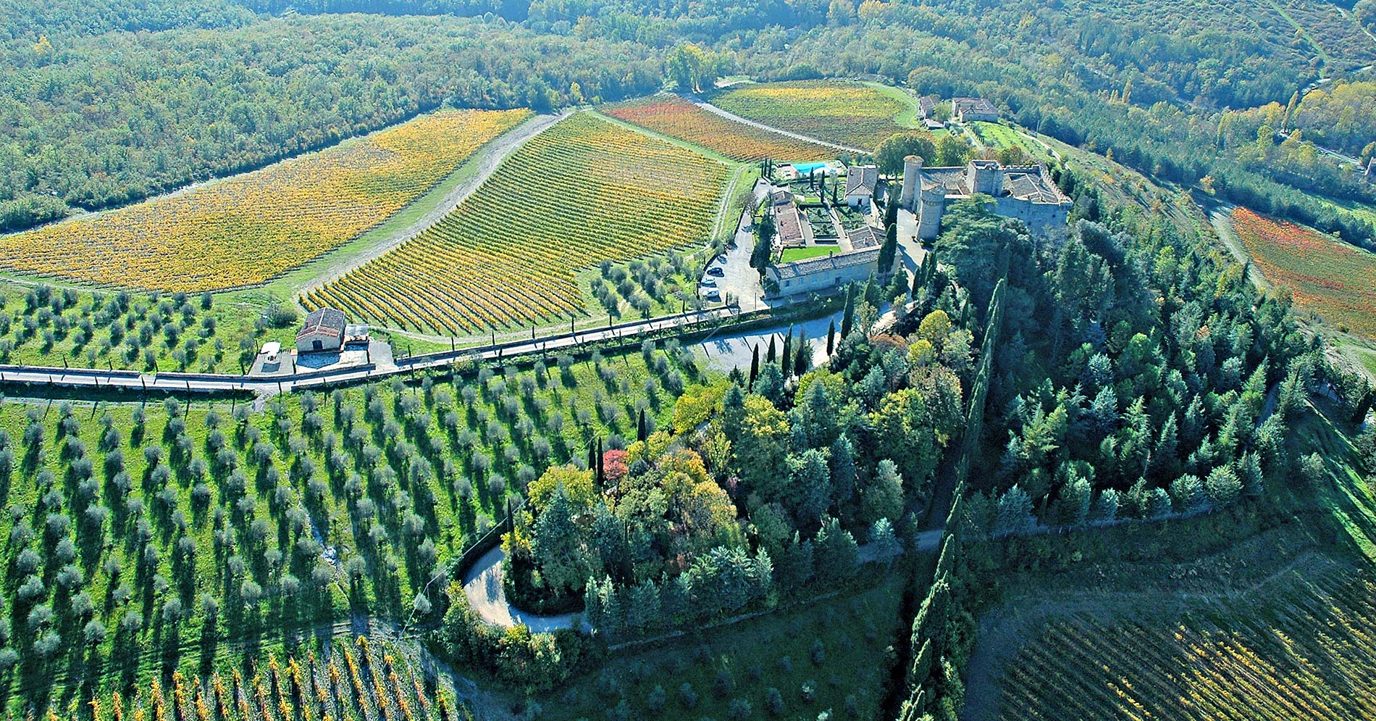

Slide 5
梅雷托堡仔细研究了哪片土地最适合葡萄种植，这些地块被分成五个独立的葡萄园，每一个葡萄园都具有自己独特的个性。

Slide 6
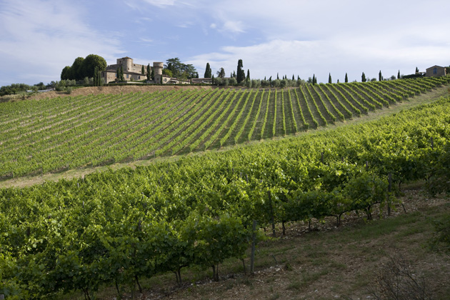
““环境可持续发展是一个艰难的挑战，但也是能创造经久不衰价值的少数事物之一”
^{Michele Contarese}
^{米盖尔·康塔忒塞，梅雷托堡商务总监}

Slide 7
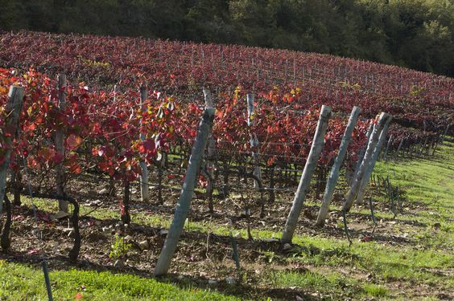

Slide 8
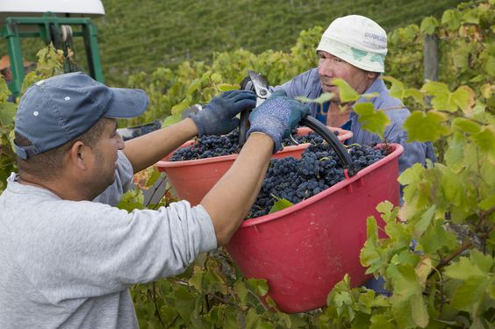

Slide 9
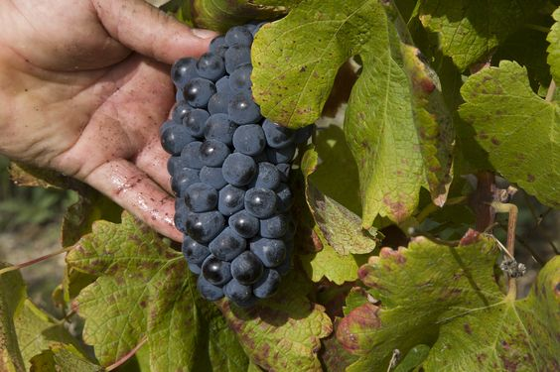

Slide 10
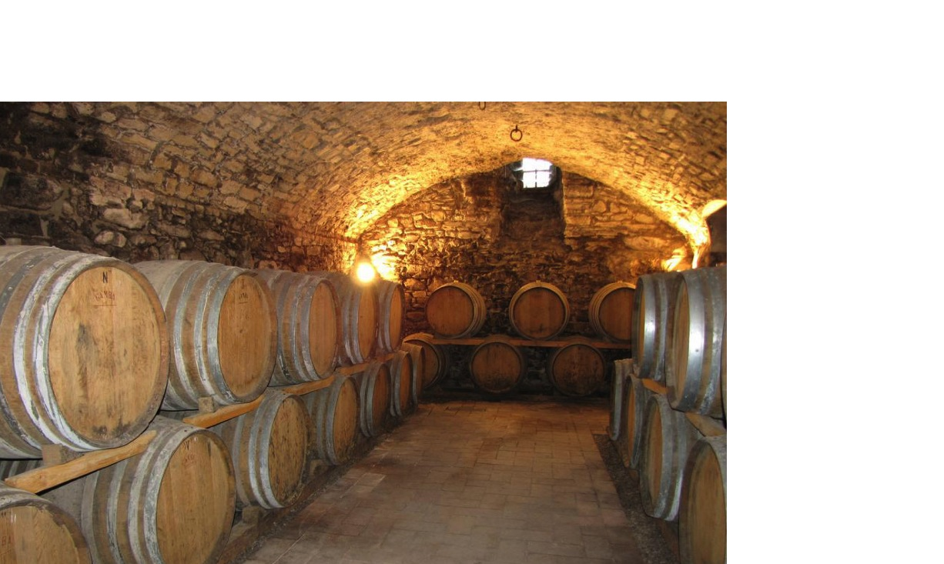

Slide 11
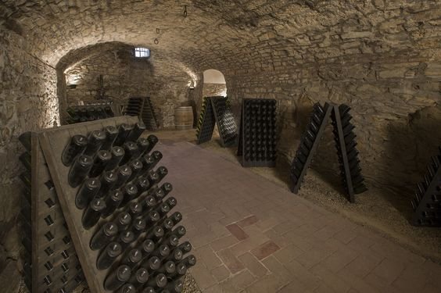

Slide 12
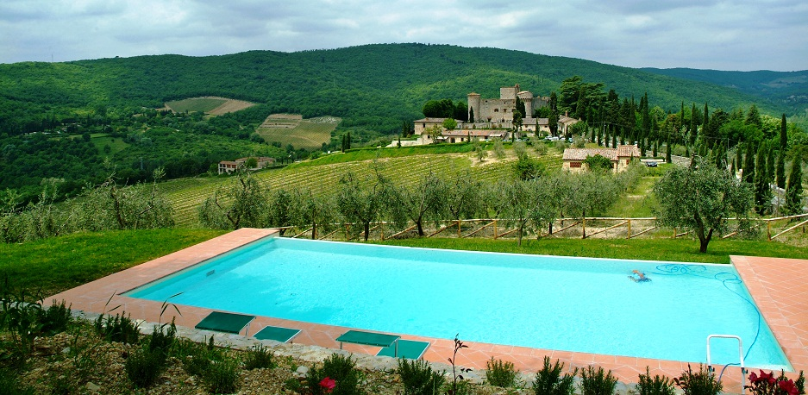
梅雷托城堡代表着托斯卡纳的灵魂

Slide 13
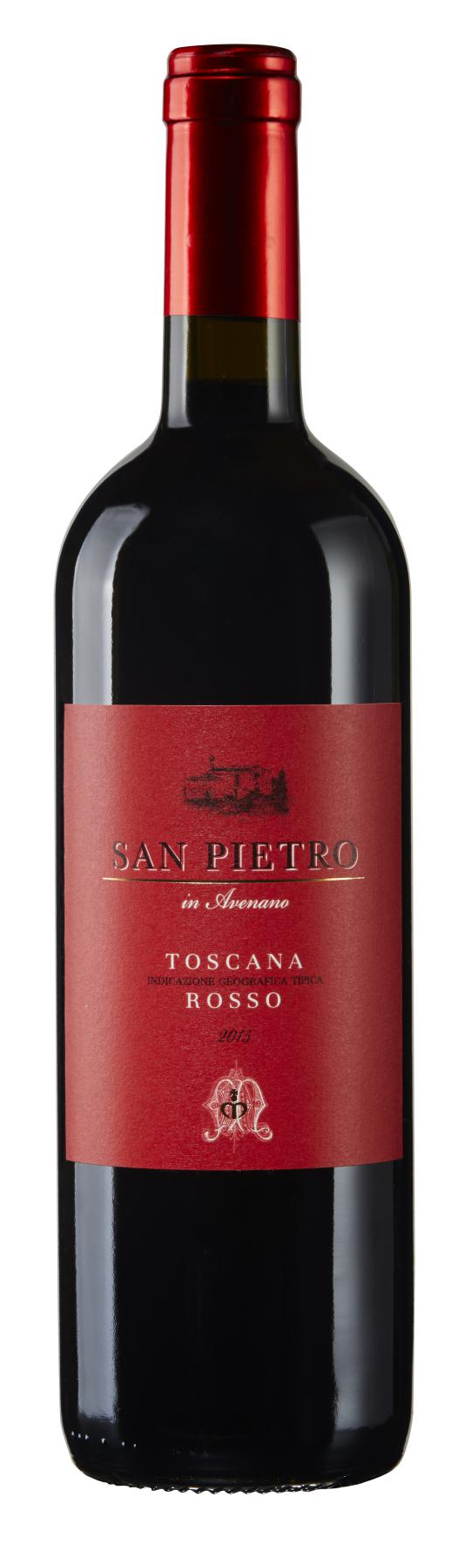
Castello di Meleto San Pietro 梅雷托堡圣嘉园干红
Origin产地: Chianti Classico, Tuscany, Italy.意大利,托斯卡纳,经典奇安蒂
Grape葡萄品种: Sangiovese, Malvasia. 桑娇维赛，玛尔维萨
Vinification: Grapes are destemmed and lightly pressed, the juice spontaneously ferments in stainless steel tanks at a maximum temperature of 25°C; after fermentation wine remains in contact with skins for 15-20 days before racking in cement tanks where wine undergoes malolactic fermentation.Most of the wine ages in stainless steel for 10-12 months, while a small part is aged in second and third use barrels for the same period of time.
酿制：去梗并轻柔压榨，带渣于不锈钢桶内控温25度自然发酵，酒精发
酵后浸皮15-20天，随后移入水泥槽中进行乳酸发酵。主要于不锈钢桶中
陈酿少部分酒液于二次或三次桶中陈酿10至12个月。
Tasting Notes: Deep ruby red, with notes of red berry fruits and hints of violet. Pleasantly fresh and round with soft tannins. Good persistence on the finish.
品酒辞：深宝石红色，具有红莓果香和些许紫罗兰香调，令人愉悦的新鲜
口感和圆润绵软的单宁，余味持续 。
Medal(s)获奖:
2012年份：酒评家 James Suckling 90/100分。
2014年份：意大利 Veronelli指南 86分。

Slide 14
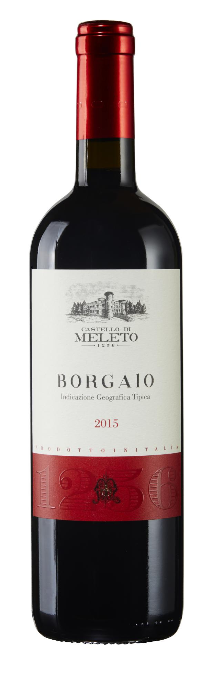
Meleto BORGAIO 梅雷托堡圣博园干红
Origin产地: Chianti Classico, Tuscany, Italy.意大利,托斯卡纳,经典奇安蒂
Grape葡萄品种: Sangiovese, Merlot. 桑娇维赛，梅洛
Vinification: Grapes are destemmed and lightly pressed, the juice spontaneously ferments in stainless steel tanks at a maximum temperature of 25°C; after fermentation wine remains in contact with skins for 15-20 days before racking in cement tanks where wine undergoes malolactic fermentation.Most of the wine ages in stainless steel for 10-12 months, while a small part is aged in second and third use barrels for the same period of time.
酿制：去梗并轻柔压榨，带渣于不锈钢桶内控温25度自然发酵，酒精发
酵后浸皮15-20天，随后移入水泥槽中进行乳酸发酵。主要于不锈钢桶中
陈酿少部分酒液于二次或三次桶中陈酿10至12个月。
Tasting Notes: Deep ruby red, with notes of red berry fruits and hints of violet. Pleasantly fresh and round with soft tannins. Good persistence on the finish.
品酒辞：深宝石红色，具有红莓果香和些许紫罗兰香调，令人愉悦的新鲜
口感和圆润绵软的单宁，余味持续 。
Medal(s)获奖:
2012年份：酒评家 James Suckling 90/100分。2015年份：酒评家 James Suckling 91/100分。
2014年份：意大利 Veronelli指南 86分。

Slide 15
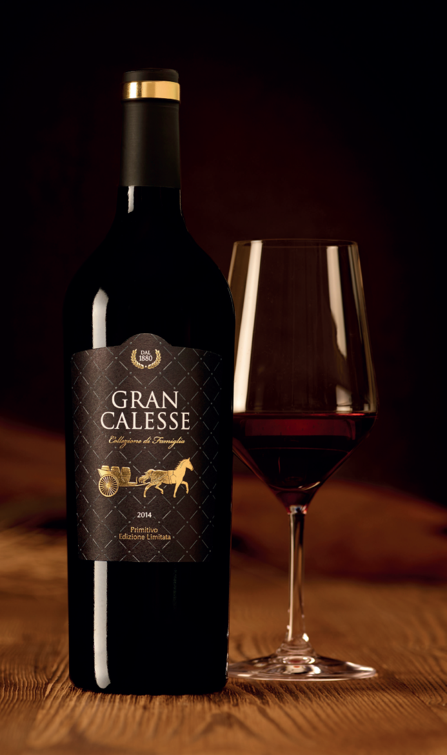
GRAN CALESSE 2014 Primitivo 骏酿普瑞米提芙干红葡萄酒限量版2014
UNCOMPROMISING QUALITY FOR MAXIMUM INDULGENCE 品质不凡，令人沉醉
★ THE PREMIUM PRIMITIVO COLLECTED FROM THE FAMILY VAULT.
来自家族地下酒窖的高级普瑞米提芙葡萄酒
★ A LIMITED EXCLUSIVE FROM PERFECTLY MATURE GRAPES
使用完全自然成熟的葡萄酿造，且限量专供
A heat wave in August and little precipitation in September allowed the 2014 primitivo grapes to ripen perfectly just in time for optimal harvesting.
This uncompromising selection of the best grapes makes the GRAN CALESSE 2014 an all-around brilliant wine full of richness and
density.
It charms discerning connoisseurs and experts with its complex, exceedingly rich and seductive bouquet, its splendid, concentrated and intense flavors of ripe cherries and fresh plum jam, and its long finish with soft vanilla notes.
The GRAN CALESSE was created exclusively for the SCHULER St. JakobsKellerei as a strictly limited edition.As an expression of exclusivity and rarity, each bottle of this majestic wine is individually numbered.
2014年，普瑞米提芙葡萄经过八月份的热浪炙人、九月份微乎其微的降水；在最佳采摘时间完全自然成熟。这些顶级葡萄在经过严格的筛选后，被用于酿制口感丰富、香气浓郁、色泽明亮的优质美酒 — GRAN CALESSE 2014。
这款葡萄酒口感层次丰富、酒香诱人，夹杂熟樱桃和清新李子酱馥郁的绝妙风味，绵软的香子兰回味悠长，征服了众多品酒家和专业人士的味蕾。
GRAN CALESSE骏酿为轩乐酒业 (SCHULER St.JakobsKellerei) 独家酿制，并且数量极其有限。每瓶都有唯一编号，彰显尊贵和稀有。

Slide 16
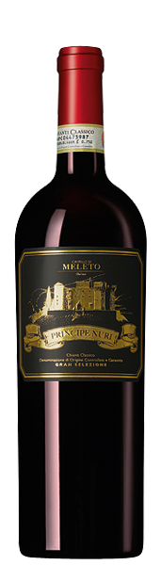
Castello di Meleto 2010 Principe Nuri 梅雷托堡精选光之子干红葡萄酒 2010
Origin产地: Chianti Classico, Toscana, Italien. 经典基安蒂，托斯卡纳，意大利
Grape葡萄品种: Sangiovese, Merlot, Cabernet Sauvignon. 桑娇维赛，美乐，赤霞珠
Vinification: Aged 18 months in high quality barriques and then another 12 months in a large oak barrel. The final three months of in-bottle aging in the wine cellar of the castle .
酿制： 在最好的法国橡木桶内陈酿18 个月之后，接着在大橡木桶内陈酿12个月，
装瓶后于酒庄酒窖内瓶中陈酿3个月
Tasting Notes: This artful blend consists primarily of the Tuscan noble Sangiovese, while 10% Cabernet Sauvignon for optimal structure and 10% Merlot for unparalleled smoothness round out this perfectly balanced masterpiece of Italian wine culture. The exclusive grape selection and 30-month onsite aging process, this excellently balanced wine impresses tasters with its great structure, full-bodied taste and complex aroma.
品酒辞：这款至臻艺术的多品种混酿，主要由托斯卡纳高贵的桑娇维塞酿制，10%
的赤霞珠为该酒提供了理想的骨架和酒体，10% 的梅洛则增添了一种无与伦比的柔
顺。由于高规格的葡萄甄选和长达30个月的陈年过程，这款光之子带给饮者一种平
衡至极的印象，骨架坚实，口感饱满，且香气复杂多变。
Pairs with食物搭配: Festive meals, leg of lamb, rabbit, stews, lasagna, game dishes. 节日盛宴、羊腿、兔肉、 炖菜、意式千层面、野味
Medal(s) 获奖:
罗伯特 帕克得分96分;《葡萄酒爱好者》杂志得分96分;
Robert Parker 96/100; Wine Enthusiast 96/100.

Slide 17
